Slide 1
Flight price Predication
Presented by:
Omar Khan
Seefaleslam Beleed
Mohamed al Jazzazi
Data used

Slide 2
Agenda
Objective.
Business Questions
Data Description
EDA.
Data Preprocessing.
Model Selection.
Conclusion.
Business Solution and Recommendations.

Slide 3
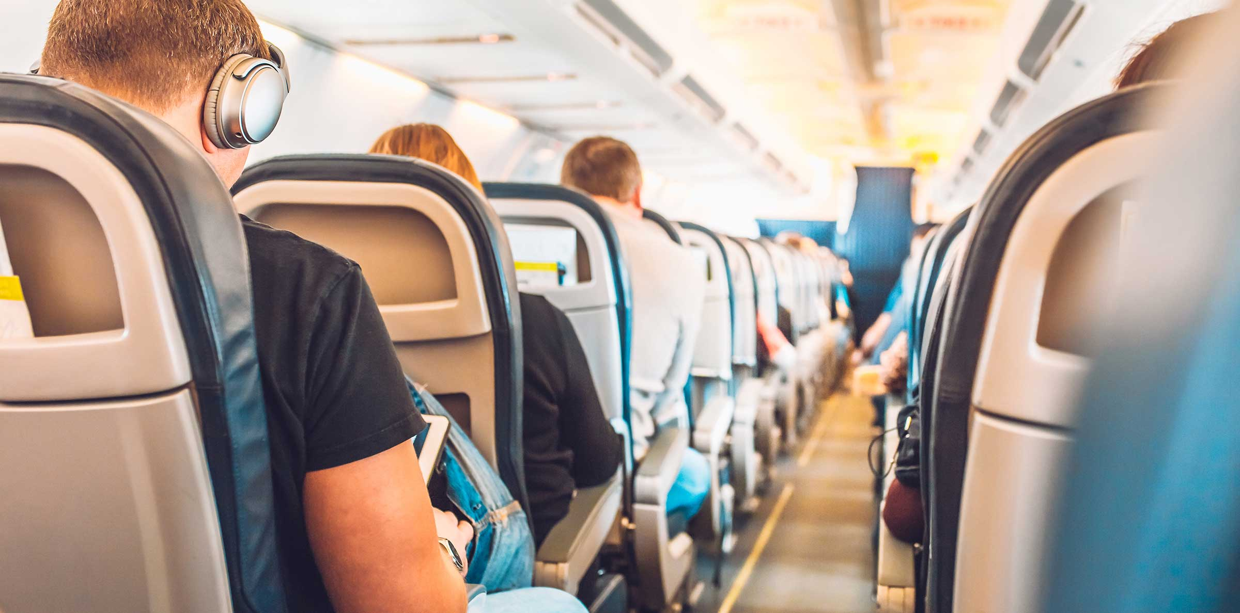

Slide 4
Objective
Our objective is to analyze airlines data to make an accurate flight price prediction model. The goal is to help customers make the best, most suitable choice for their flight so that they get their desired features for a good price.
We provide a comfortable service for customers in choosing an appropriate flight and get a comfortable, time-saving, affordable airline experience.

Slide 5
Business Qs
?!!
How does the ticket price vary between Economy and Business class?
Does price vary with Airlines?
How is the price affected when tickets are bought in just 1 or 2 days before departure?
Does ticket price change based on the departure time and arrival time?
How the price changes with change in Source and Destination?
Does the number of stops influence the price?
What variables influence most the price?

Slide 6
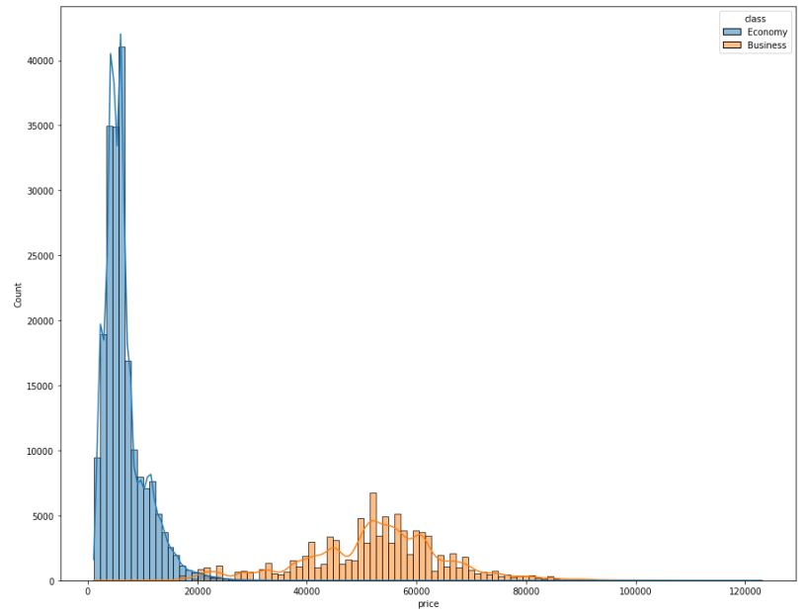
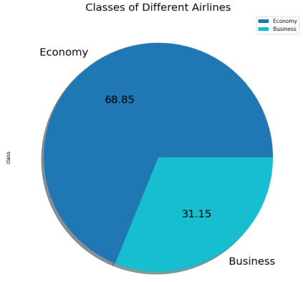
EDA
Economy class passengers are a way more than business class, while the price of business class is higher.

Slide 7
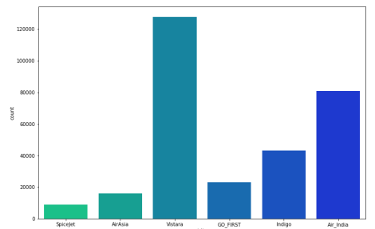
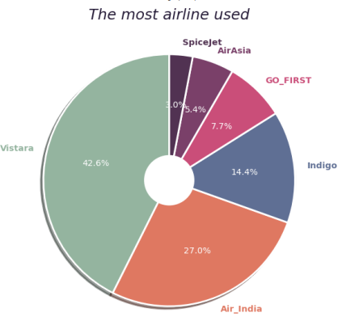
EDA
Vistara is the most used airline, followed by Air_India

Slide 8
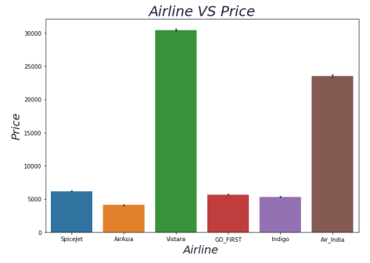
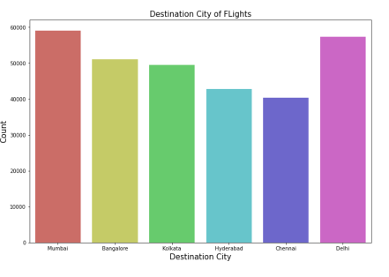
EDA
Mumbai and Delhi are the most attractive destinations for customers.
Vistara price is six times higher than nearly the rest of other airlines.

Slide 9
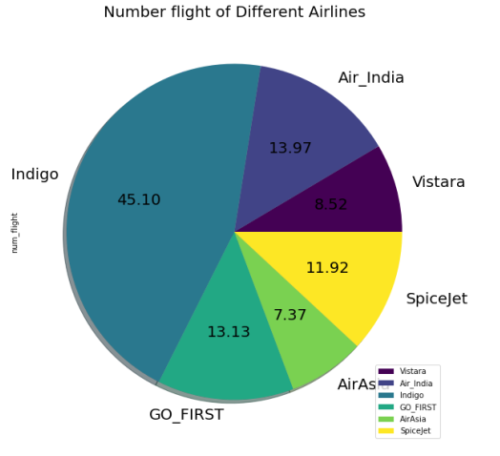
EDA
people's demand for airlines is not related to the number of flights for the company.

Slide 10
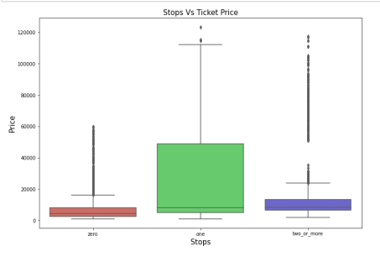
EDA
Flights having zero stop has maximum ticket price
Mumbai and Delhi are the most attractive destinations for customers.

Slide 11
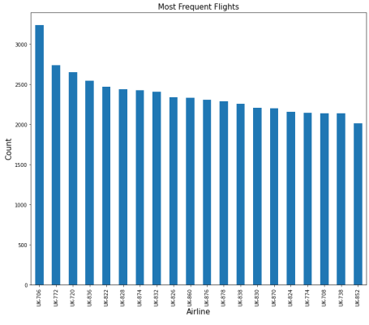
EDA
Most Frequent Flights
Most frequent flights are from Delhi to Mumbai

Slide 12
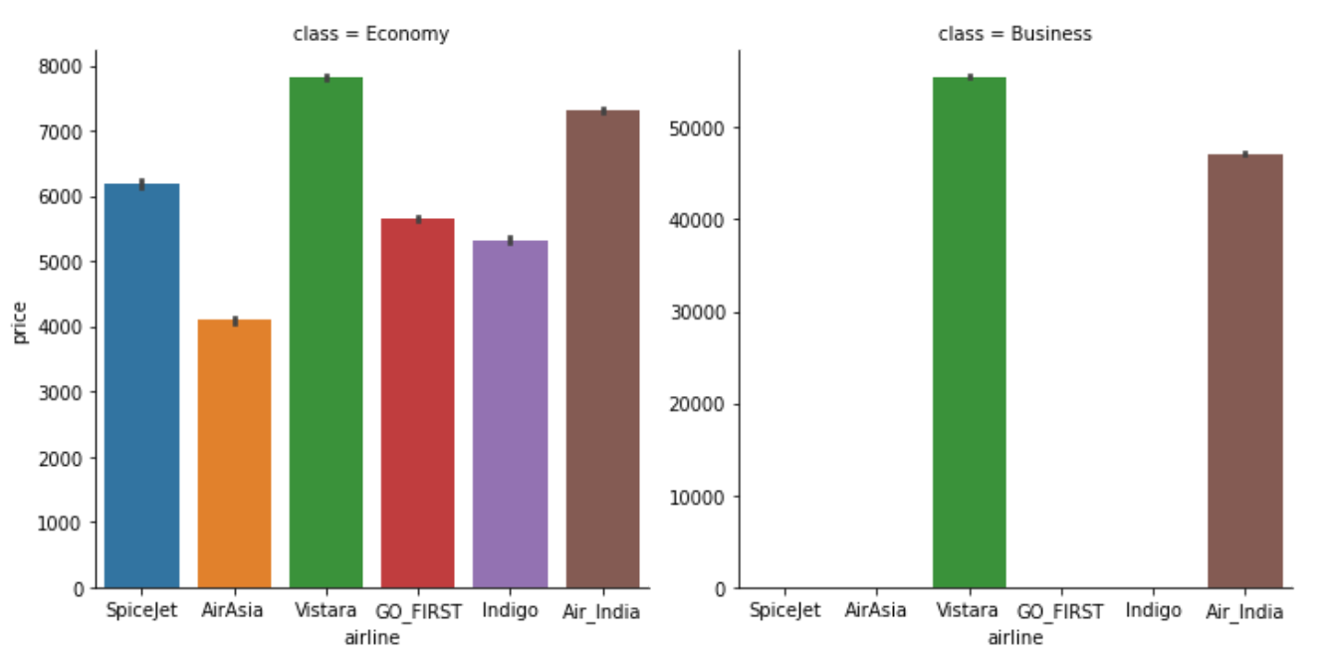
EDA
Vistara and Air_india are the passengers choice for the business class booking.

Slide 13
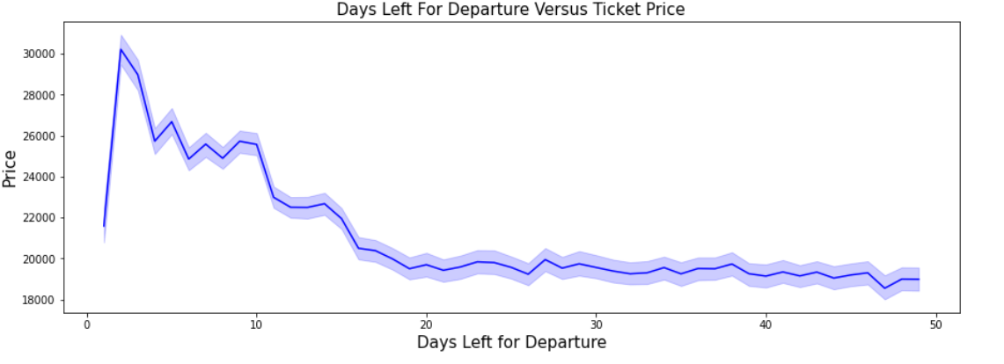
EDA
Ticket price increases as the days left before departure decreases.

Slide 14
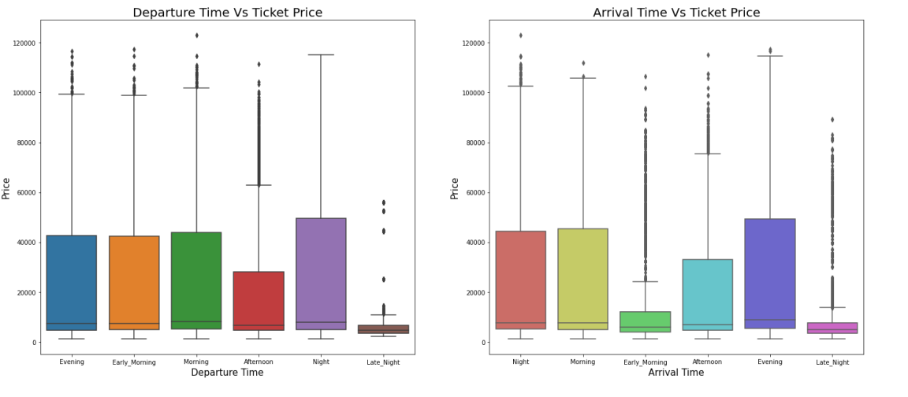
EDA
Ticket Price is More for the Flights when the Departure Time is at Night.
Ticket Price is More for the Flights when the Arrival Time is at Evening.

Slide 15
Data Description
Number | Columns
1 | Unnamed: 0
2 | Airline
3 | Flight
4 | Source_city
5 | Departure_time
6 | Stops
7 | Arrival_time
8 | Destination_city
9 | Class
10 | Duration
11 | Days_left
12 | Price
Rows
300153
Columns
12

Slide 16
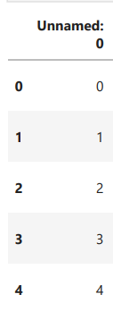
Data preprocessing
1. Feature Selection
Dropping unnecessary features
The “Unnamed:0” feature doesn’t relate to the price or other features.

Slide 17
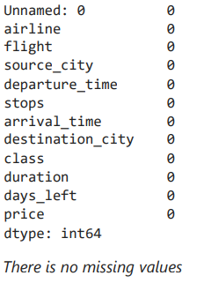
Data preprocessing
2. Removing Nulls
There was no missing values.
3. Removing Duplicates
There was no Duplicates in Data.

Slide 18
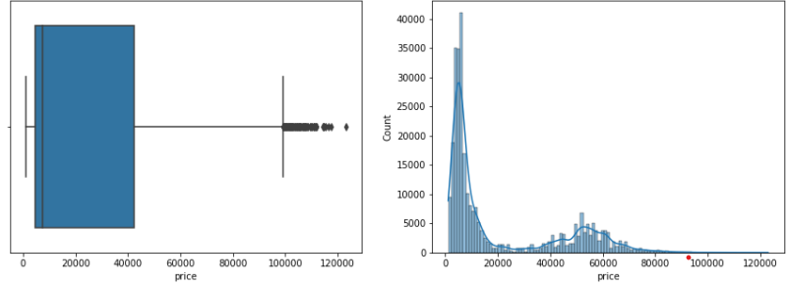
Data preprocessing
4. Handling Outliers
Handling outliers in the price .

Slide 19
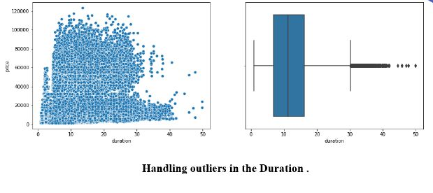
Data preprocessing
4. Handling Outliers

Slide 20
Model Selection
Models used
1- Linear Regression
2- Ridge Regression
3- Lasso Regression
4- Decision tree
5- Random Forest
6- XGBoost

Slide 21
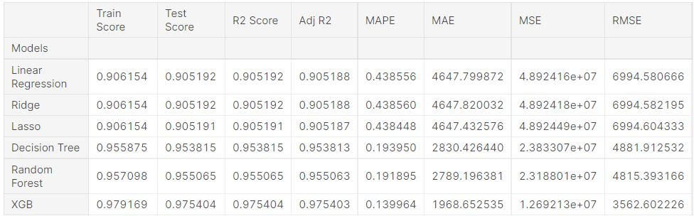
Model Selection
Comparison between Models

Slide 22
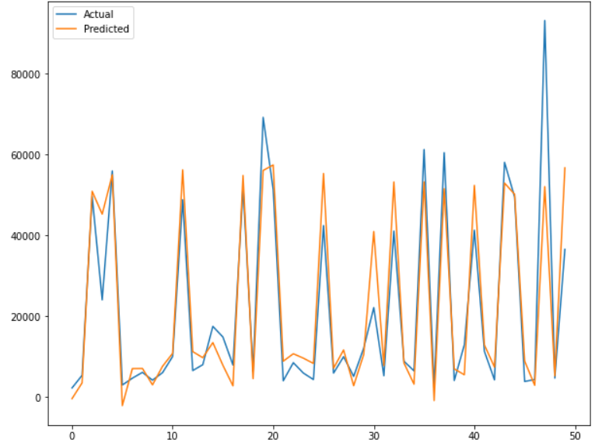
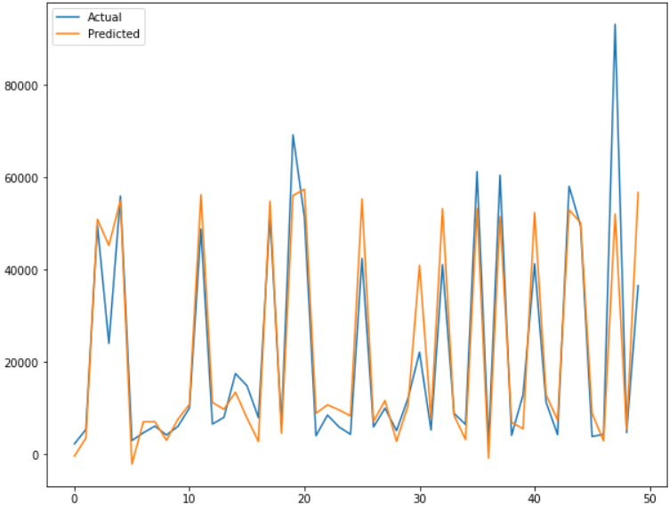
Model Selection
Linear Regression
Ridge Regression

Slide 23
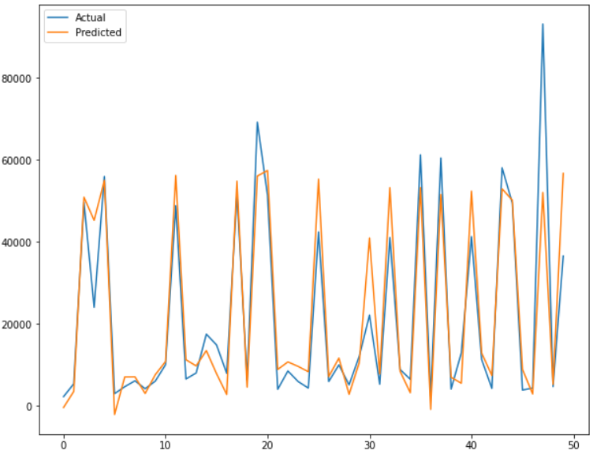
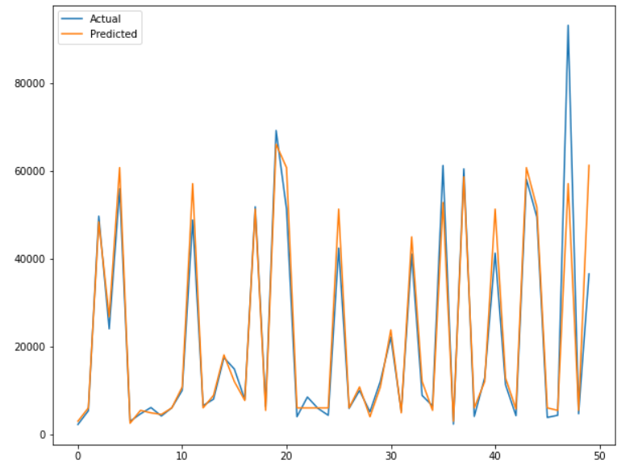
Model Selection
Lasso Regression
Decision Tree

Slide 24
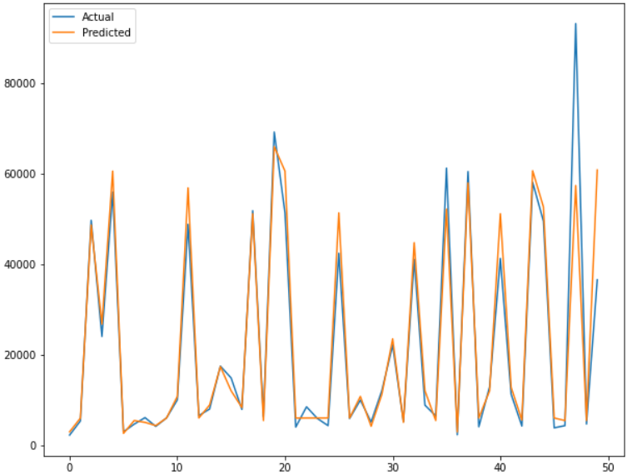
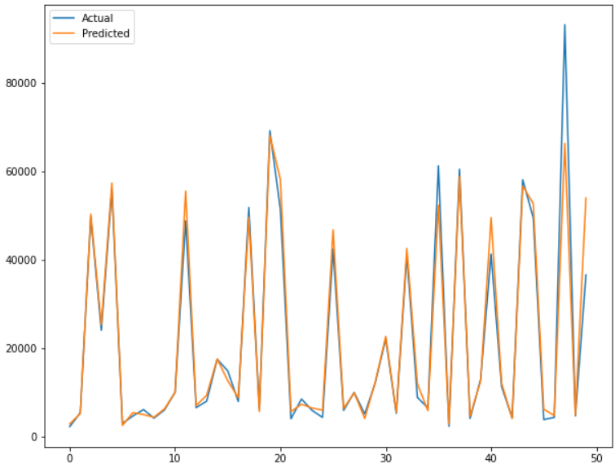
Model Selection
Random Forest
XGBoost

Slide 25
Conclusion
After analyzing the data, we concluded that each person has different criteria for choosing his airline. So, we need to gather many data ad most as possible to provide each customer a variety of choices for the best experience.

Slide 26
Business solutions and recommendations

Slide 27
Business solutions & Recommendation
To improve airlines and flights
Improve customer service as it is so important in the airline industry.
Aircraft Interior Products.
Follow-up With Passengers.

Slide 28
Business solutions & Recommendation
We recommend that :
If the customer wants a business class, we recommend Vistara and Air_India.
The price of the ticket increases with the remaining days before departure, so we advise customers to book the ticket early in order to get the best price.
If customers want tickets at a low price, late-night flights are suitable for the purpose.

Slide 29
Thank You !

